Slide 1

DEPARTMENT OF ARTIFICIAL INTELLIGENCE AND DATA SCIENCE ACADEMIC YEAR 2025 - 2026 SEMESTER III ARTIFICIAL INTELLIGENCE LABORATORY MINI PROJECT REVIEW AI-Based Personality Prediction System
REGISTER NUMBER | 2117240070115
NAME | HEMAPRIYA R
YEAR | 2
SECTION | B
FACULTY IN-CHARGE | Mrs. M. Rubina begam

Slide 2
PROBLEM STATEMENT
Introduction & Background: AI-Based Personality Prediction project applies AI concepts to analyze user responses and predict personality types — Introvert, Extrovert, or Ambivert. Personality prediction is valuable in recruitment, counseling, and personal development, helping users understand themselves better.
Problem Statement: To develop an AI-based system that predicts an individual’s personality type based on their answers to behavior-related questions using an interactive GUI.
Goal & Expected Result: The goal is to design a user-friendly personality prediction app using a Rule-Based Scoring Algorithm. The system outputs the user’s personality type accurately and can be extended using machine learning models for improved prediction and personalization.

Slide 3
THEORETICAL BACKGROUND
Theoretical Background: AI-based personality prediction analyzes user behavior or responses to identify personality traits. Traditional AI systems use rule-based reasoning, while modern methods apply machine learning and NLP for deeper insights. This project focuses on decision-making through symbolic AI (rule-based approach).
Justification for Algorithm Choice: The Rule-Based Scoring Algorithm was chosen for its simplicity, interpretability, and suitability for questionnaire-based prediction. It provides clear logic and accurate results without training a model.
Algorithm Explanation (Example): Each question carries a weight representing introversion or extroversion.
“Strongly Agree” = high positive score (toward extroversion)
“Strongly Disagree” = low score (toward introversion) Total score determines the final personality: 🔹 Low = Introvert 🔹 Mid = Ambivert 🔹 High = Extrovert

Slide 4
IMPLEMENTATION AND CODE
Link to code in Git-hub Repository
List | Git-hub Repository Links
Implementation of Code Link | https://github.com/Hema0501/AI_MiniProject.git
Word Document Report Link | https://github.com/Hema0501/AI_MiniProject.git
PPT Link

Slide 5
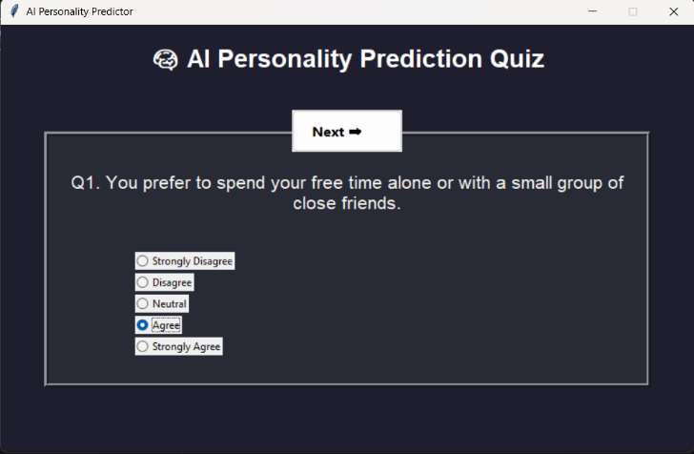
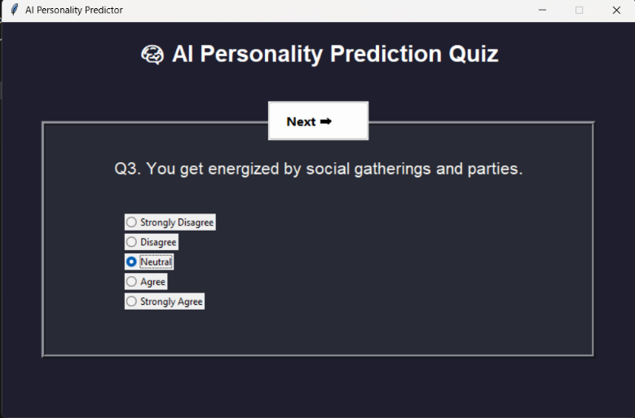
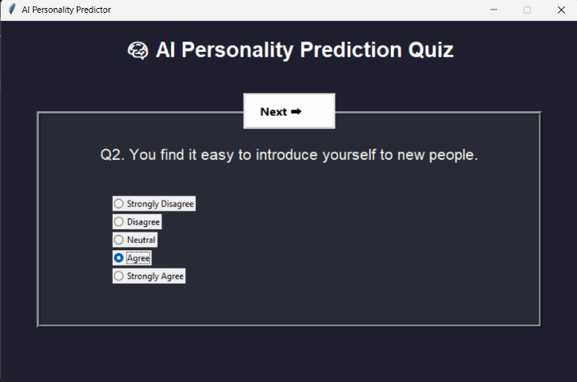
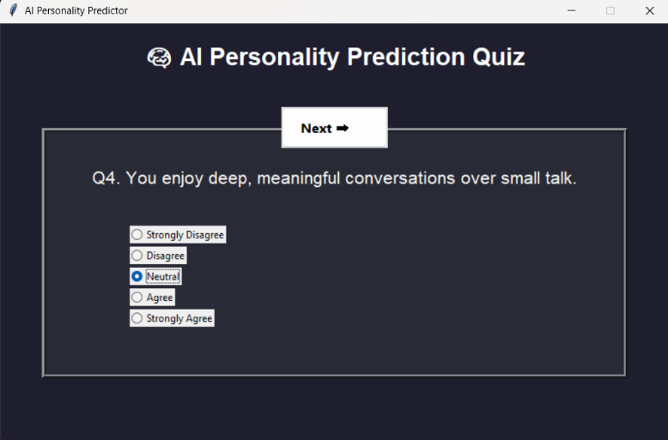
OUTPUT AND RESULTS
The application displays a sequence of 10 carefully designed questions that analyze user behavior and preferences. Each question presents five response options ranging from “Strongly Disagree” to “Strongly Agree.” As users progress through the quiz, their answers are recorded and scored to determine their personality type.

Slide 6
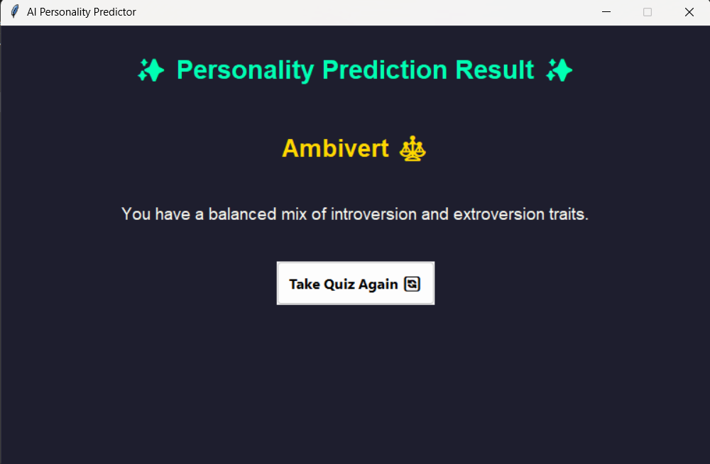
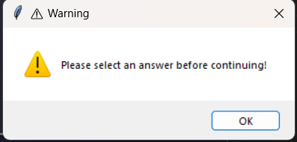
OUTPUT AND RESULTS
After answering all 10 questions, the application computes the overall score and displays the user’s predicted personality type. The result screen is visually appealing, with color-coded backgrounds for each type — blue for Introvert, yellow for Extrovert, and green for Ambivert. It also includes a short description summarizing key traits of the detected personality and a “Restart” button for retaking the quiz.
If the user clicks the “Next” button without selecting any option, a warning popup appears with the message “Please select an answer before continuing!” This ensures that every question receives a valid response before proceeding. Such validation improves accuracy and provides a smoother, error-free user experience.

Slide 7
REFERENCES
Russell, S., & Norvig, P. (2020). Artificial Intelligence: A Modern Approach (4th ed.). Pearson.
Jurafsky, D., & Martin, J. H. (2023). Speech and Language Processing (3rd ed. draft). Available online (Stanford / authors' website).
Bishop, C. M. (2006). Pattern Recognition and Machine Learning. Springer.
Scikit-learn documentation — Text feature extraction and classifiers. https://scikit-learn.org/stable/
Kaggle — MBTI dataset: mbti_1.csv (used for future NLP extension). https://www.kaggle.com/datascienceai/mbti-type
TkDocs / Tkinter reference: https://tkdocs.com/ (for GUI best practices and examples)

